Slide 1
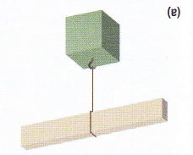
A Basic Tension Problem
The 1.0Kg mass is at rest. What is the tension on the string?

Slide 2
A Basic Tension Problem
The 1.0Kg mass is at rest. What is the tension on the string?
F_{T} = 1.0Kg x 9.81 m/s² or F_{T} = 9.8 N

Slide 3
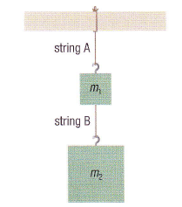
Added Tension
The masses are at rest.
What is the tension on string A?
What is the tension on string B?
0.5Kg
1.0Kg

Slide 4
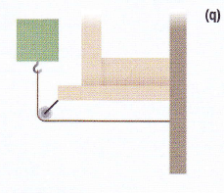
Hanging Tension
The 1.0Kg mass is at rest.
What is the tension on the string?
What is the applied force on the wall?

Slide 5
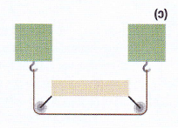
Tension In Balance
Both masses are 1.0Kg and are at rest. What is the tension in the string?

Slide 6
Tension Tester
All three masses are at rest. Find the value of the unknown mass?
7Kg
? Kg
15Kg

